Slide 1



Farmconnect Kenya
Our tagline: Empowering Farmers. Supplying businesses .Founder:Gilbert Udo
01

Slide 2
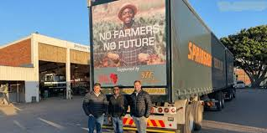

Problem statement:
Farmers struggle to access reliable markets and often face middlemen exploitation.
Stores & businesses lack a consistent supply of fresh, affordable farm products.
Supply chain inefficiencies → high food prices & wastage.
10

Slide 3

Solution
A Farm Management & Ordering System where:
Farmers list their available produce.
Stores & businesses place bulk orders directly from farmers.
System manages inventory, orders, payments, and delivery logistics.
06

Slide 4
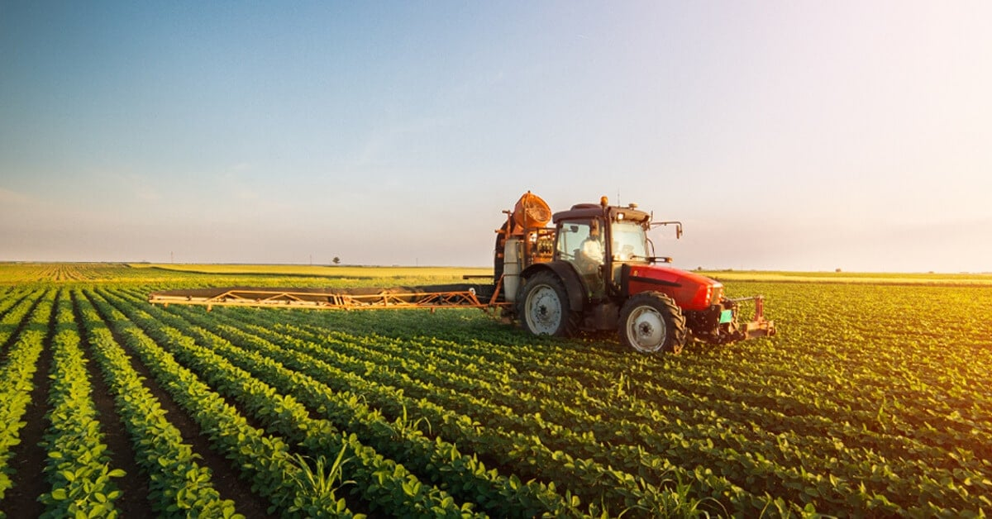
What FarmConnects kenya does:
Farmers & Businesses – Provides a digital marketplace where farmers list produce and stores/businesses order directly.
Simplifies Ordering & Payments – Businesses place bulk orders and pay securely via M-Pesa or bank.
Farm Management Tools – Farmers track inventory, sales, and production for better planning.
Logistics & Transparency – Supports delivery integration and product traceability from farm to store.

Slide 5


Target Market
33%
Agriculture contributes to Kenya GDP.
$10 Billion
Agri-supply chain
14

Slide 6
Market Size
TAM: All agricultural produce supply chain.
SAM: Fresh produce to stores, hotels, schools.
SOM: Initial focus on Nairobi & major towns.

Slide 7
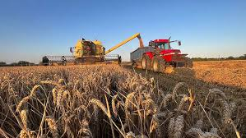
Competitors
Informal brokers (middlemen)
Existing platforms: Twiga Foods, DigiFarm, M-Farm
Differentiation
Farm management system + marketplace
Focus on transparency, traceability, fair pricing
Direct farmer-to-business model
23

Slide 8

Competitive Advantage
Differentiation
Farm management system + marketplace
Focus on transparency, traceability, fair pricing
Direct farmer-to-business model

Slide 9
Project Traction
Tasks
Month 1
Month 2
Month 3
Month 4
Month 5
IDEA GEN
PLANNNING
REQUIREMENT GATHERING
SYSTEM DEVELOPMENT
PROTOTYPE TESTING
LAUNCH
MAINTENANCE
23

Slide 10

Business Model
Transaction Commissions – Earn a percentage (5–10%) from every order made between farmers and businesses.
Premium Subscriptions – Farmers pay monthly/annual fees for advanced features (analytics, priority listings, bulk buyer access).
Logistics Fees – Revenue from delivery charges or partnerships with transport providers.
Data & Analytics Services – Sell market insights (demand trends, pricing, supply forecasts) to businesses, NGOs, and government.
23

Slide 11
Go To Market
Partner with farmer cooperatives, SACCOs & county governments for farmer onboarding.
Conduct training & sensitization programs in farming communities.
Direct outreach to supermarkets, hotels, schools, and restaurants.
Digital marketing through social media, WhatsApp groups, and targeted ads.
Build strategic partnerships with logistics providers, NGOs, and financial institutions.
Use referral programs & word of mouth to grow both farmers and businesses.

Slide 12
Social Impact
Farmers: Higher income (20-30%), fair prices, reduced post-harvest loss.
Businesses: Reliable supply, reduced costs.
Kenya: Stronger food supply chain, digital agriculture growth.

Slide 13
Our Ask
Seeking KSh 10 Million (USD 75,000) in seed funding to develop and scale FarmConnect Kenya.
Use of Funds
Technology Development – KSh 4,000,000 (40%)
Build & scale the web and mobile platform.
Add farm management tools, payment & logistics integration.
Farmer & Business Onboarding – KSh 2,500,000 (25%)
Training sessions, community outreach & onboarding campaigns.
Work with farmer cooperatives & SACCOs.
Marketing & Customer Acquisition – KSh 2,000,000 (20%)
Social media campaigns, roadshows, demos.
Partnerships with supermarkets, hotels, schools, restaurants.
Operations & Logistics Partnerships – KSh 1,000,000 (10%)
Build transport/delivery collaborations.
Support order fulfillment & reliability.
Team & Administration – KSh 500,000 (5%)
Hire support staff.
Cover legal, admin & office costs.

Slide 14

Team Members
GILBERT UDO
FOUNDER

Slide 15




Thank you!
Contacts :+254797122038
17

